Slide 1
ARRAYS

Slide 2
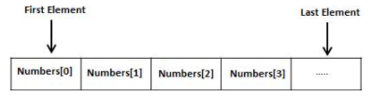
ARRAYS
An array is a collection of variables of the same type that are referenced by a common name. In C, all arrays consists of contiguous memory locations. The lowest address corresponds to the first element, and the highest address to the last element. Arrays may have from one to several dimensions. A specific element in an array is accessed by an index.

Slide 3
One Dimensional Array
The general form of single-dimension array declaration is:
type variable-name[size];
Example
int sample[10];
In C, all arrays have zero as the index of their first element.

Slide 4
Example 1
#include <stdio.h>
int main()
{
int marks[10], i, n, sum = 0, average;
printf("Enter number of elements: ");
scanf("%d", &n);
for(i=0; i<n; ++i)
{
printf("Enter number%d: ",i+1);
scanf("%d", &marks[i]);
sum += marks[i];
}
average = sum/n;
printf("Average = %d", average);
return 0;
}

Slide 5
Initializing Arrays
It is possible to initialize an array during declaration.
int mark[5] = {19, 10, 8, 17, 9};
You can also initialize an array like this.
int mark[] = {19, 10, 8, 17, 9};

Slide 6
Two-dimensional arrays
Two dimensional arrays are stored in a row-column matrix where the first index indicates the row and the second indicates the column. This means that the right most index changes faster than the leftmost when accessing the elements in the array in the order in which they are actually stored in memory.
Syntax:
type arrayName [x][y];

Slide 7
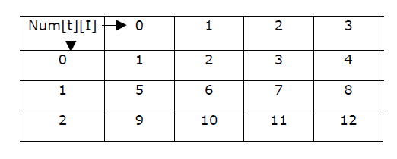
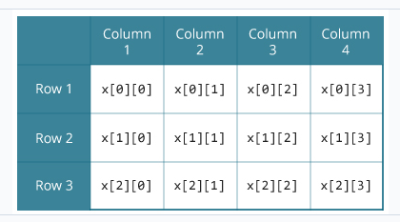
2D Example
Int num[3][4];

Slide 8
Initializing 2D Array
int c[2][3] = {{1, 3, 0}, {-1, 5, 9}};
int c[][3] = {{1, 3, 0}, {-1, 5, 9}};
int c[2][3] = {1, 3, 0, -1, 5, 9};

Slide 9
Example
#include <stdio.h>
int main() {
float average;
int i,j, grades[2][5];
grades[0][0] = 80;
grades[0][1] = 70; grades[0][2] = 65;
grades[0][3] = 89;
grades[0][4] = 90;
grades[1][0] = 85;
grades[1][1] = 80;
grades[1][2] = 80;
grades[1][3] = 82;
grades[1][4] = 87;
for (i = 0; i < 2; i++) {
average = 0;
for (j = 0; j <5 ; j++) {
average += grades[i][j];
}
printf("The average marks obtained in subject %d is: %.2f\n", i, average);
}
return 0;
}

Slide 10

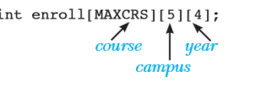
Multi dimensional Arrays
store the enrolment data for a college
assume that the college offers 100 ( MAXCRS ) courses at five different campuses
Students from any of the four years can opt for the courses

Slide 11
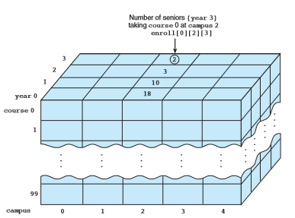

Slide 12
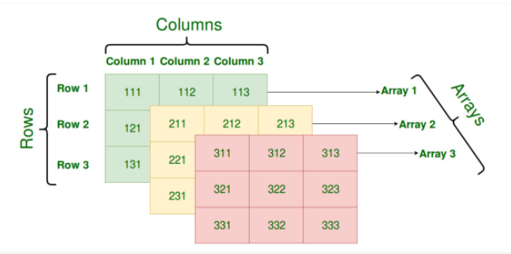
Three dimensional Array

Slide 13
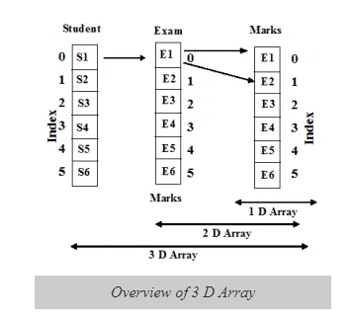

Slide 14
Example
for(int i=0; i<2;i++){
for(int j=0; j<3;j++){
for(int k=0; k<2;k++){
printf("%d\n",marks[i][j][k]);
}
}
}
return 0;
}
#include <stdio.h>
int main()
{
int marks[2][3][2];
marks[0][0][0]=67;
marks[0][0][1]=45;
marks[0][1][0]=56;
marks[0][1][1]=78;
marks[0][2][0]=56;
marks[0][2][1]=89;
marks[1][0][0]=45;
marks[1][0][1]=69;
marks[1][1][0]=50;
marks[1][1][1]=90;
marks[1][2][0]=91;
marks[1][2][1]=72;

Slide 15
Example
#include<stdio
using namespace std;
int main()
{
int x[2][3][2] =
{
{ {0,1}, {2,3}, {4,5} },
{ {6,7}, {8,9}, {10,11} }
};
// output each element's value
for (int i = 0; i < 2; ++i)
{
for (int j = 0; j < 3; ++j)
{
for (int k = 0; k < 2; ++k)
{
cout << "Element at x[" << i << "][" << j
<< "][" << k << "] = " << x[i][j][k]
<< endl;
}
}
}
return 0;
}

